Slide 1

Chapter 18
Implementation
Mom, what do reliability engineers really do?
Objectives, Functions, and Processes
The Economics of Reliability
Data Collection Systems
Chapter 18

Slide 2
Reliability Engineering
Objectives, Functions, and Processes
The overall objective of reliability engineering is to insure that the final product will be both economically reliable and reliably safe.
Economically reliable means that the product’s observed reliability has been established with consideration of the life cycle costs involved.
  This would include both the acquisition costs and the costs of failures (including perhaps customer goodwill costs).
Reliably safe requires designing sufficient reliability into the product to insure that the probability of accidents, injury, or death resulting from a product failure is within an acceptable limit.
Chapter 18

Slide 3

Can you list the functions of a reliability engineer for us?
Quantifying reliability requirements as design goals or specifications,
Allocating or apportioning reliability requirements to system components and parts,
Applying reliability design methods during product development (parts selection, derating, etc.),
Performing R&M analysis (block diagrams, stress-strength, redundancy, R&M trade-offs , etc.).
Conducting a FMEA program,
Participating in design reviews,
Establishing test procedures and conducting reliability testing,
Performing a reliability prediction or demonstration,
Developing a reliability plan.
Chapter 18

Slide 4

Maintainability Engineers
The objective of maintainability engineering is to insure restoration of a failed system or product is accomplished in a timely and safe manner.
The economics of repair considers the trade-offs among product reliability, repair time, maintenance resources and spare parts requirements.
With these grades, I can be a maintainability engineer.
Chapter 18

Slide 5

Grandpa, can you tell me the story again about your days as a maintainability engineer when you maximized profits through maintainability design reviews?
Quantifying maintainability requirements as design goals or specifications,
Allocating or apportioning maintainability to system assemblies and components,
Applying maintainability design methods during product development (fault isolation, modularization, etc.)
Performing maintainability and availability analysis (R&M trade-offs , maintenance resourcing, establishing preventive maintenance intervals, spares provisioning, etc.).
Participating in design reviews,
Performing a maintainability prediction and demonstration,
Developing a maintainability plan.
Chapter 18

Slide 6
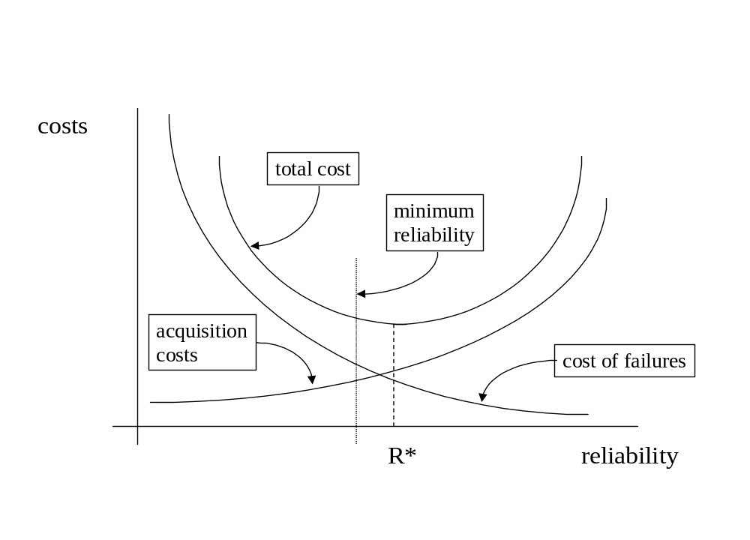
The Economics of Reliability
Chapter 18

Slide 7
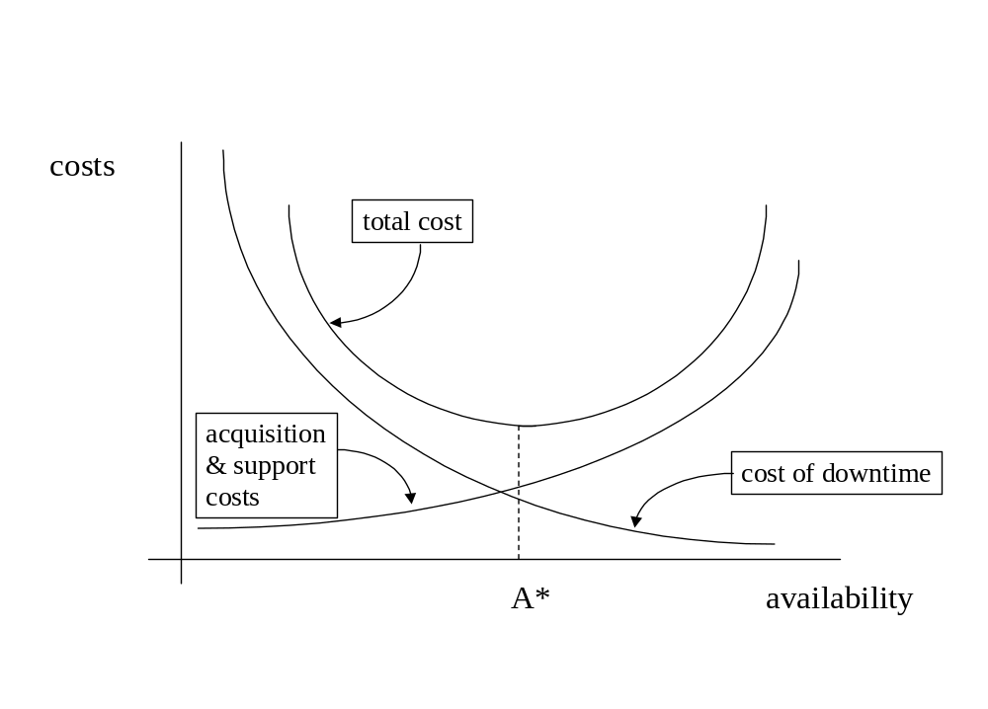
Cost versus Availability
Chapter 18

Slide 8
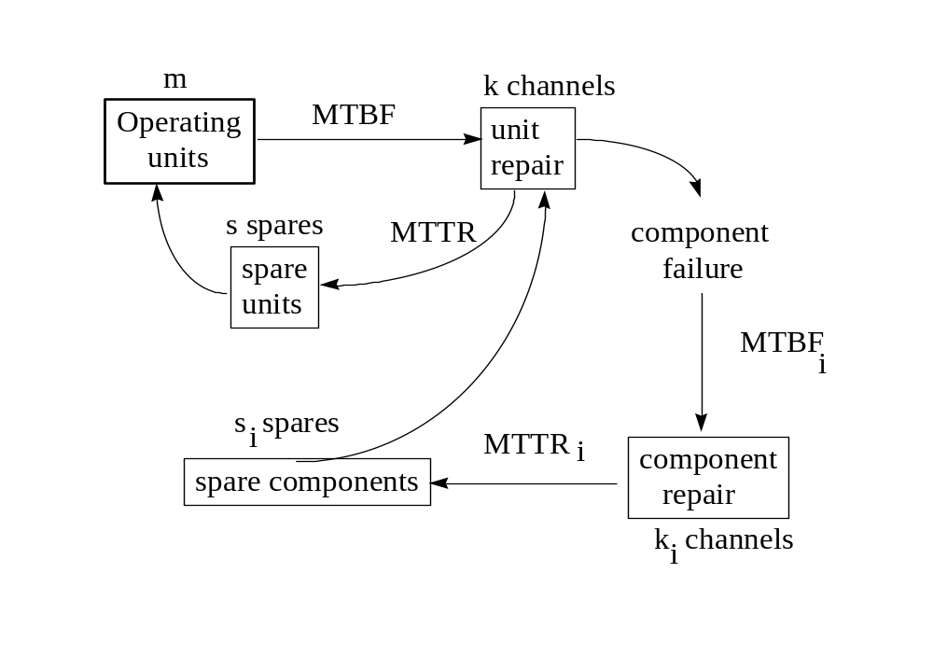
System Repair Cycle
Chapter 18

Slide 9
Product Life Cycle Activities
Product Phase | Sources of R&M Data | R&M Tasks
Initial design | Databases (Mil-Hdbk) Vendor specifications Comparability Analysis | Establish goals & specs R&M allocation life cycle costing FMEA
Detailed design & prototyping | Reliability & product testing Maintainability demonstration reliability growth testing | R&M predictions Design methods and trade-offs FMEA
Production | Quality Control Burn-in and stress testing Acceptance inspections Life testing | Redesign and modifications
Operations | Field Data Warranty data | Preventive maintenance Overhaul Sparing & parts replacement
Chapter 18

Slide 10

What data should I be collecting?
Data Element Definition
Failure Number A sequential number identifying a failure record
Date/Time Date and time the failure is recorded
Part ID The specific component or part which has failed
Failure Time The age of the part (in a reliability sense) at the time of failure (not when discovered) measured in failure time units (e.g. operating hours, cycles, miles, etc.).
Failure Mode The exact nature of the failure (short, overload, impact fracture, power failure, break, etc.)
Failure Cause If identifiable such as excessive vibration, fatigue, corrosion, power surge, human error, or Mechanism maintenance induced, normal fatigue wear, etc.
Chapter 18

Slide 11
More R&M Data Elements
Data Element Definition
Start Repair The date/time hands-on corrective maintenance began (does not include time waiting for spares or maintenance resources)
Stop Repair The date/time all restoration has been completed
Action Taken The type of maintenance performed to correct the failure such as remove and replace, minor adjustment, calibration, rebuild, etc.
Crew Size The number of individuals performing corrective maintenance (if the number varies during restoration then use a weighted average)
Chapter 18

Slide 12
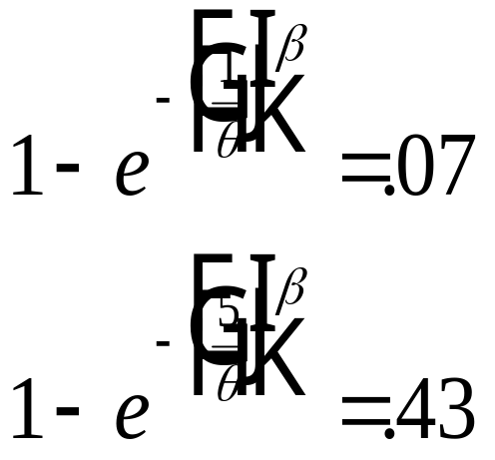
Service Contracts
Example 18.2
Statistics show that 7 percent of all VCRs sold need servicing during their first year and 43 percent need servicing within five years. If Weibull failure times are assumed, the parameters can be estimated by solving the following two nonlinear equations:
Chapter 18

Slide 13
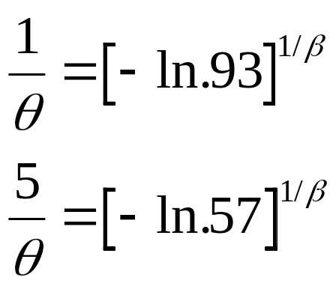
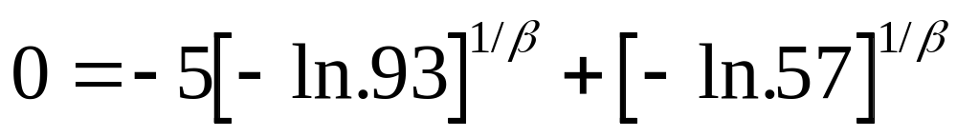
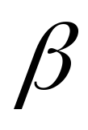

Service Contracts
=1.272
= 7.86
MTTF = 7.292 yrs, t_{med} = 5.892 yrs., t_{mode} = 2.338 yrs.
Std. dev. = 5.774 yrs., 90 percent design life = 1.34 yrs
R(4 yrs) = .65, R(10) = .26
Chapter 18

Slide 14
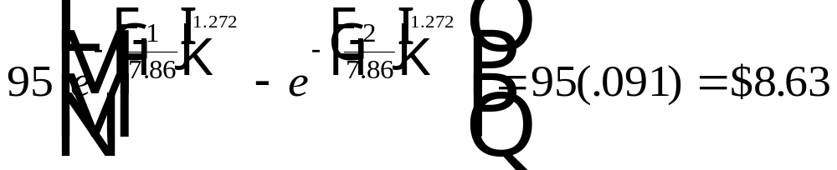
Service Contracts
=1.272
= 7.86
The average cost of a repair is $95.00. The first year is
covered by the warranty. The customer can purchase a
Service contract for the second year at a cost of $50.
The economics; the expected repair cost the second year:
Chapter 18

Slide 15
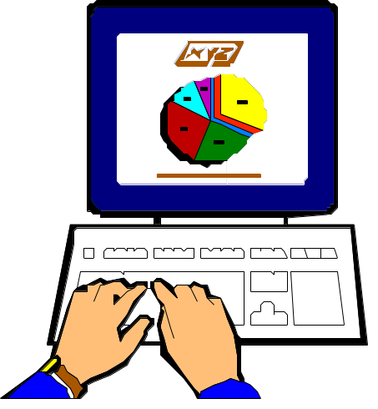
18.6 Software Reliability
The probability of failure-free operation of a computer program for a specified time in a specified environment.
Chapter 18

Slide 16
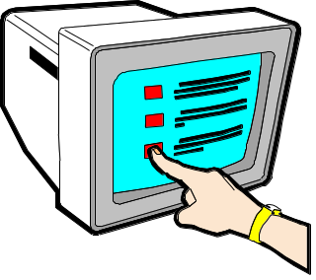
Software Reliability
Concerned with how well the software functions to meet the requirements of the customer.
Redundancy in the hardware sense does not work.
Represents a user-view of software quality.
  relates to operation rather than design and testing.
Source of failures are faults
  originating from errors in requirements, design, coding
Changes continuously during (reliability growth) testing.
The user discovers a “failure”
Chapter 18

Slide 17

Fault (Defect) vs. Failure
Failures are dynamic occurring over time. Time (“age”) may be
measured as execution time, test time (labor hours or test execution hours), or calendar or elapsed time.
Software reliability can be measured by
1. time of failure
2. time between failures
3. cumulative failures at time t
4. total failures in a time interval
Alternate approach is to define reliability as the probability that the software will fulfill its mission. For example, two distinct modules S₁ and S₂ perform the same identical function where time to execute T₁ < T_{2.} If both modules generate incorrect output, which is more reliable?
Chapter 18

Slide 18
Why treat failures as random?
Two sources of randomness:
The commission of errors by programmers, and hence the generation of faults, is a very complex, unpredictable process.
  therefore the location of faults within a program are unknown.
The conditions of execution of a program are generally unpredictable.
  therefore the paths to be taken cannot be determined.
A fault is a defect (bug) in a program which causes a failure.
A fault is a property of a program rather than a property of its execution.
Chapter 18

Slide 19
Failure Distribution affected by:
The number of faults in the software
  number introduced - number removed
  introduced during coding but may be a result of requirements or design defects
The execution or operational profile of the system
  cannot remove a fault unless detected
  detection resulting from execution depends on the length of execution time and the operating environment
Faults may be found through inspection (code audits), compiler diagnostics, design and code reviews.
Chapter 18

Slide 20

Cascading Errors
Generates high
level design
error
Generates low
level design
error
Requirement
Specification error
Generates coding
error
High level
design error
Generates low
level design
error
Generates coding
error
As a software engineer,
I know how important
it is to find errors early
in the development
cycle.
Low level
design error
Generates coding
error
Coding
error
Chapter 18

Slide 21
Software Reliability Models
Definition:
A Mathematical model constructed for the purpose
of assessing the reliability of software from specified
parameters which are either assumed or are estimated
from observable data.
Primary functions:
R(t) - reliability at time
ρ(t) - intensity function
n(t) - expected (cumulative) number of failures at time t
Chapter 18

Slide 22
Software Reliability Models
Time-to-failure models
  characterized by a time to next failure distribution
  typically based upon the exponential
Error counting models
  characterized by the number of remaining errors
  typically based upon the Poisson
Unique Models
  error complexity model
Chapter 18

Slide 23
Reliability Models - typical assumptions
Monotonic (decreasing) failure intensity function
Faults are independent
Perfect and instant removal of faults once discovered (as opposed to batch fixes)
(Usually) a finite number of faults are present
Time between failures are independent
Intensity function is related to number of errors remaining
NHPP (CFR between defect removals)
Chapter 18

Slide 24

The Reliability Engineer
Reliability Engineers are a sad and embittered race. A lonely group despised by both the design team and management; their sole function being to generate failures. And generate failures they will! For it is their very life, their ambrosia, their reason for being. Many a good designer has quietly disappeared after receiving one too many failures. Management has lost their stock options because the reliability growth curve did not grow. No wonder the poor reliability engineer dines alone, talks to no one, and has no friends. Their only hope to escape the despair of the day to day job comes with the knowledge that all things must fail, and eventually as the reliability life test runs to its inevitable conclusion, so will they.
I am going to be a reliability engineer.
Chapter 18

